Slide 1
RPO and Talent Solutions aren’t just for the big agencies… and we are going to prove it!

Slide 2
Stop ambulance chasing…
Contingent recruitment:
High waste levels (fill ratio)
Low / Limited Profitability
No or limited client commitment
Shifting sands and moving goal posts
Slow HR & hiring manager feedback with lack of control
Typically, an average at best candidate experience
Adds no value to client brand
100% success fee based… with replacements and rebate fees
Limited Enterprise Value contribution for agency
1-2x 3-5x 6-9x 10x+

Slide 3
The contingent recruitment trap
Price / Cost
?
Products & Services
Customer Experience
UX & UI

Slide 4
Escaping the contingent recruitment trap : RPO & MSP
Existing products
New products
Penetration
Expansion
Innovation
Aggression
Existing markets
Market penetration
Product
development
INCREASED RISK
INCREASED RISK
Market
development
Diversification
New markets
Market development
Diversification
INCREASED RISK

Slide 5
Clients who want it all…
High Quality
(Better)
Fast as possible
(Quicker)
Good Value
(Cheaper)
Want all three… Then its RPO
Value adding high touch service that’s guaranteed to deliver on time, then it needs to be retained and you give priority
Good service at low cost, then we need real exclusivity and client to be financially committed, but could be slower and less effective
Low cost and fast then its contingent, but why would anyone choose that?
Committed
Retained
RPO
Contingent

Slide 6
Recruitment Process Outsourcing
The RPO market forecast:
8.75bn
33.34bn
2023
2032
Source: Polaris Market Research

Slide 7
The RPO opportunity for SME agencies
72% of organisations outsource only part of their business to an RPO provider
53% of RPO pricing models include a cost per hire and a fixed monthly management fee
79% of HR outsourcing solutions are for perm hires only
20% of organisations use RPO services for ‘projects’

Slide 8
What do we mean by RPO: Delivery Models
RPO Delivery Models
Project RPO
Complete handling of manpower requirements of a project
Candidate sourcing, screening, assessment and on-boarding
100% candidate ownership, management and replacement
Partial RPO
Moving part of its recruitment process
Dedicated team to manage the process as defined in the SLA
Continuous reporting and analysis
End to end RPO
Complete handling of the manpower sourcing of an organisation
Candidate sourcing, screening, assessment and onboarding
100% candidate ownership with accountability for performance through SLA’s
Scope of Service

Slide 9
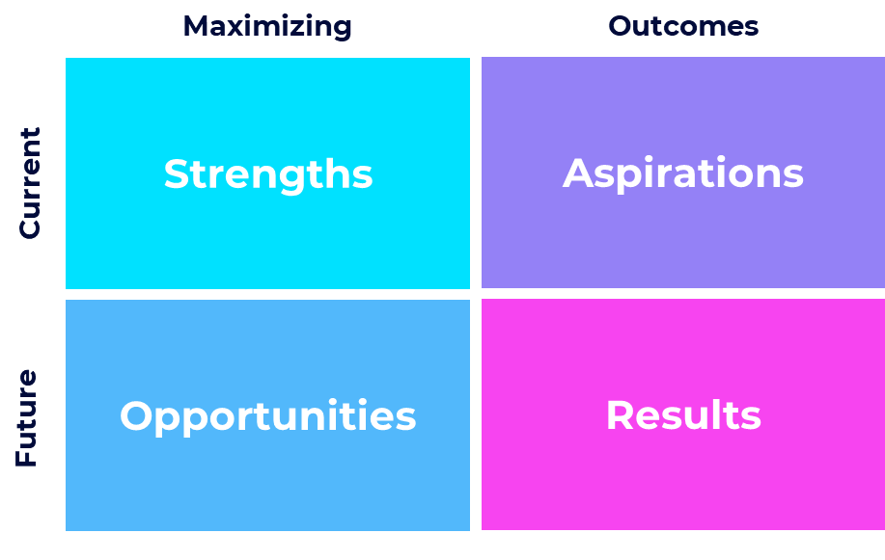
Where are your opportunities / What are your expected results

Slide 10
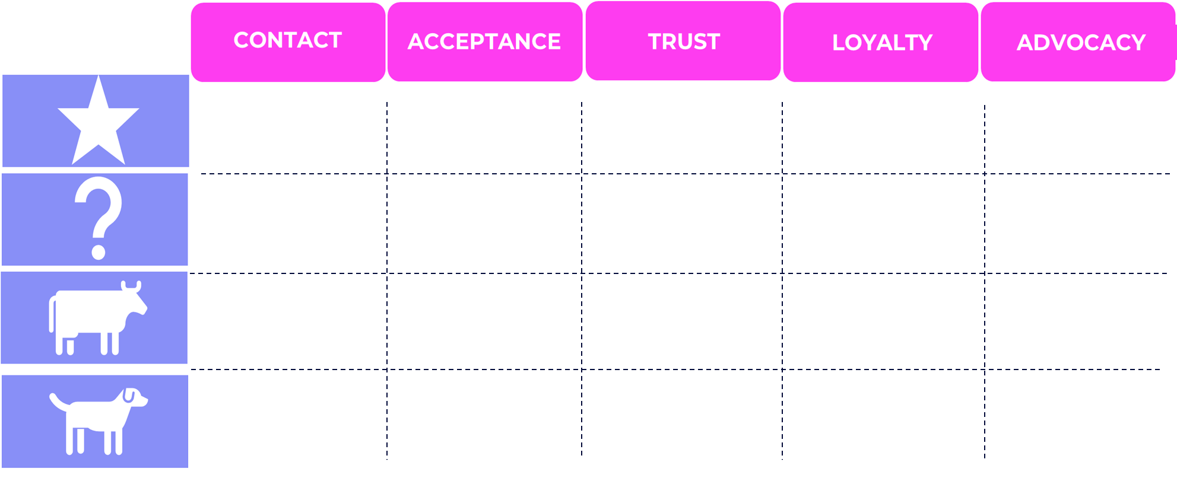
Knowing where to take your RPO first?
Who are your ‘most suitable’ clients right now

Slide 11
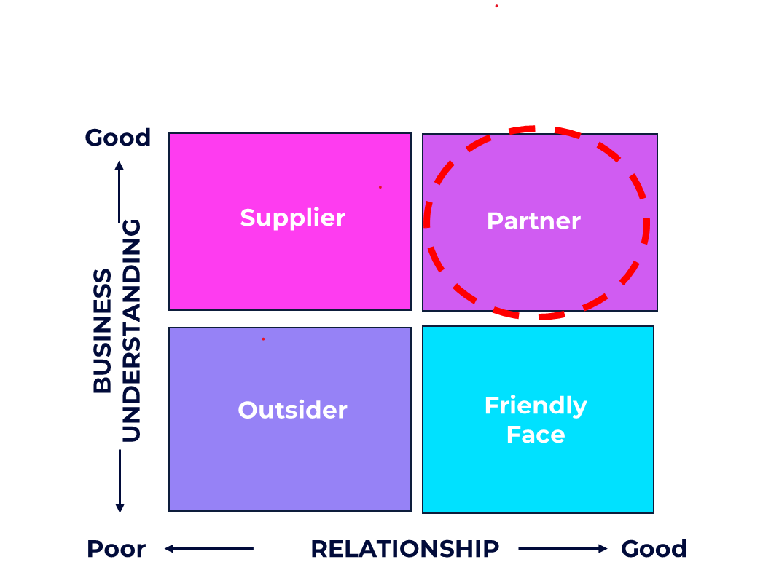
You need to become your clients talent partner

Slide 12
Where are your clients experiencing their pain... … be the antidote
Time to Hire
Process
Culture
Cost to hire
Quality of hire
Retention

Slide 13
Positioning your killer RPO Talent Solution
Your Value Proposition
Competitor Offering
Customer Requirements
Sweet Spot
So What
Shit Spot
Sour Spot

Slide 14
Building a killer RPO talent solution: Your RPO scope
Talent Strategy
Attraction
Sourcing
Selection
Process & Approach
On-Boarding
Learning & Development
Reward & Progression
Retain / Exit

Slide 15
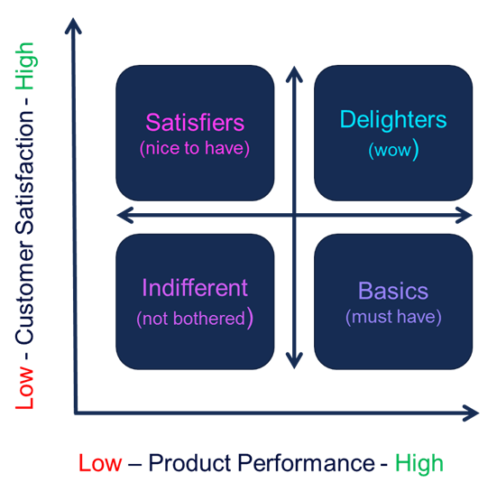
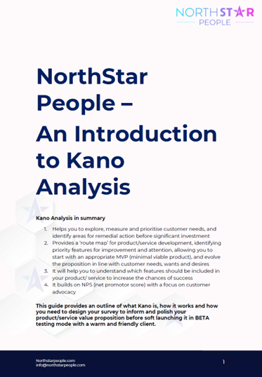
Market testing your talent solution

Slide 16
7 steps to RPO Success Programme

Slide 17
7 steps to RPO Success Programme
 | ReadinessAudit | Shaping | Strategic Sales | Tools & Techniques | Sales Coaching | Implement & Deploy | Ongoing Support | Total
Standard | FREE | £20,000 single fee |  |  |  |  |  | £20,000
Monthly | FREE | £1,950pm x 12 |  |  |  |  |  | £23,400
Modular | FREE | £7,500 | £3,125 | £3,125 | £3,750 | £5,000 | £3,750 | £26,250

Slide 18
Stop ambulance chasing…
RPO /MSP Solutions – The Proof:
Eire: 3m euro over 5 years Partial RPO - Healthcare
UK: Lancs 750k gbp over 3 years Project RPO - Manufacturing
UK: West Yorks 980k gbp over 3 years MSP - Engineering
UK: Gtr Mcr 349k gbp over 2 years Project RPO - Industrial
UK: Berks 3.75m gbp over 3 years MSP - IT
1-2x 3-5x 6-9x 10x+

Slide 19
www.linkedin.com/in/mileslloyd/
07867316626 - miles@northstarpeople.com
https://zcal.co/mileslloyd/rpo

